Slide 1
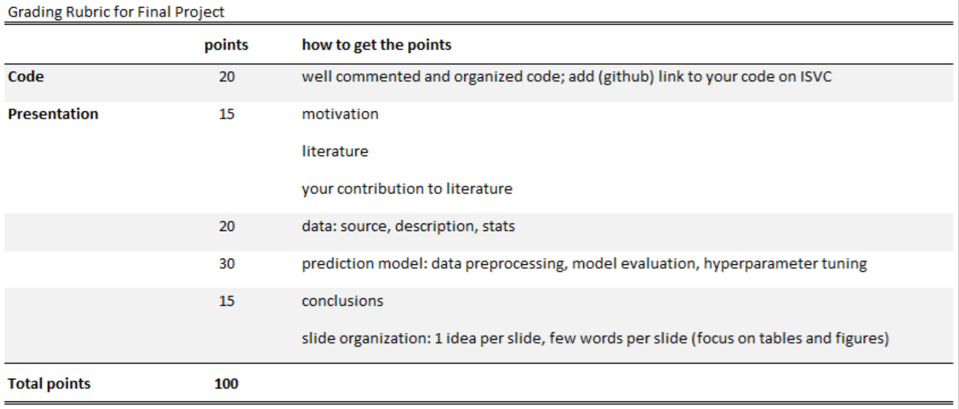
Rubric

Slide 2
W207 Final Project:
Stock Prediction Models
John Andrus, Luis Chion, Kevin Fu, Fernando Roriz
Notes:
Hi everyone, in our final project we will be discussing stock price prediction models and some of the challenges faced in such a competitive industry. My name is Fernando Roriz and I will be presenting with John Andrus, Luis Chion and Kevin Fu.

Slide 3
Motivation
Stock price prediction has been a major challenge in finance.
‘Beating the market’ is a long term goal in the field.
Machine learning can be a powerful tool to explore new approaches to the market data.
Which ML models can generate the highest returns in the stock market?
Notes:
Stock price prediction has been a major challenge in finance. As expected, ‘beating the market’ is very hard and machine learning can be a powerful tool in this never ending goal.
But, which models can generate the best results? Linear or non linear? Supervised or Unsupervised? The main idea in this project is to explore these possibilities and see which Machine Learning models perform better.

Slide 4
Literature
Since Lo and MacKinlay (RFS, 1988), the literature has established that stock market prices do not follow random walks. Fama and French (JF, 1992) and Fama and French (JFE, 1993) presented the three-factor model designed to describe stock returns.
Cochrane (RFS, 2008) shows that even small R2 (from 4% to 7%) has large economic significance and variables such as dividend-growth ratio are relevant predictors.
Gu, Kelly and Xiu (RFS, 2020) runs a comparative analysis of machine learning methods and shows that best performing methods to measure asset risk premia are trees and neural networks. These models trace their predictive gains to allowance of nonlinear predictor interactions that are missed by other methods.
At this time, many papers are being produced and published trying to apply machine learning techniques to predict stock markets and this project try to add on this strand of the literature.
Notes:
What does the finance literature say about stock market prediction?
The literature has long established that stock market prices do not follow random walks. Lo and MacKinlay in 1988 consolidated this view. Later, Fama and French, in their 1992 and 1993 papers, presented the three-factor model, an asset pricing model designed to describe stock returns. They showed that factors such as market risk, company size and book-to-market ratio were relevant to explain the variability of stock returns. These works and other contributions later gave Fama a Nobel Prize.
From these results, predicting stock prices became a major goal in the field and many articles have been published since then. Cochrane in 2008 presented a good overview of the literature on this topic and showed us that even small out-of-sample R-square’s, such as 4% to 7%, have large economic significance, despite their low statistical significance. Therefore, it is important to note that we are not aiming for R-square’s around 80% or 90%. In finance, we are fighting for small gains, but they can mean a lot in economic terms and that is our goal.
Finally, the machine learning literature has brought all these concepts to its field and the 2020 paper from Gu, Kelly and Xiu, a very recent paper in the Review of Financial Studies, shows us that machine learning models such as trees and neural networks can perform better when explaining empirical facts such as asset risk premia. According to them, the gains come from the fact that these models allow nonlinear interactions between predictors, a feature that is missed by many other methods.
At this time, many papers are being produced and published trying to apply machine learning techniques to predict stock markets and this project tries to add on this strand of the literature.

Slide 5
Jane Street Market Prediction - Kaggle
In this competition, for a set of possible trades presented, we have to decide if should add this trade to our portfolio or not.
Roughly, our main goal is to add to our portfolio trades that have positive returns and pass the ones with negatives returns.
For each possible trade, we are presented with 130 features and can use them to decide if this will have a positive return or not.
Notes:
How are we going to do this?
We will explore and evaluate the performance of machine learning models through a Kaggle competition. The Jane Street Market Prediction problem gives us a real market dataset and our objective is to decide, given a set of features, if we would add or not a trade to our portfolio. Using 130 features, we have to decide if the possible trades are valuable or not.

Slide 6

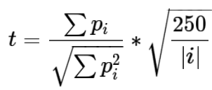

Jane Street Market Prediction - Kaggle
The return of a trade is given by the ‘resp’ variable and ‘weight’ represents the leverage for that specific trade. Finally, the ‘action’ variable is our binary target that takes value 1 if resp > 0, and 0 otherwise.
But, in the end, this competition is evaluated on the utility score given below:
,where
And |i| is the number of unique dates in the test set.
Notes:
For each trade, the dataset gives us its return, represented by the resp variable, as we can see in the first formula, and also the weight of the trade, which represents the leverage we are going to take. The action variable is our target variable and it takes value 1 if the resp variable is greater than zero, and 0 otherwise. This means that we are trying to get the trades that have positive returns.
But, in the end, this competition is evaluated on the utility score presented in the bottom part of the slide, which depends also in the term t presented right next to it. This term t is penalizing us with the variance of our strategy, as we can see in the denominator of t. In some way, this feature takes into account the risk aversion of market investors, which like higher returns, but dislike higher variance.
The formulas are a little bit complicated to understand very quickly, but what we have to keep in mind is that we want to get the trades that have positive returns.

Slide 7
Data: Source, Description, Stats
Data
~1.6 million observations of 130 anonymized features
Raw data 18% null, nulls replaced with zeros
Binary Labels (Target Variable)
1 - Make a Trade
0 - Take No Action
Named Features
Date & ts_id : Integer date and timestamp
Weight and resp : Together represent return on a trade
Pre-processing steps:
Replaced NA’s with the median
Dropped 4 highly correlated features
Notes:
Finally, for this first part, let´s go through a quick overview of our data.
The dataset has around 1.6 million trades and 130 anonymized features. Thus, this is a very agnostic problems. We are trying to predict the market and we do not even know what the features are. But, if it is good for prediction, it should be used, and we do not care about its interpretability.
The binary labels are our target variables and they are dependent on the resp variable as explained before. We will use these labels to train and test our models.
The whole dataset has 500 days and each possible trade is numerated using the ts_id variable.
We also did some preprocessing and the main steps were to replace the NA’s with the median value of the feature. We also normalized them and dropped the highly correlated features to start reducing the dimensionality of our problem, which we will see is a major issue when we come to more computational intensive models.
With this overview of the project, I will now turn the floor over to John.

Slide 8
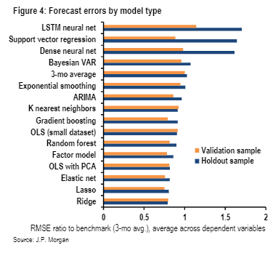
Model Evaluation
Goal is to maximize utility score, not accuracy score)
Per the literature, we focused on these models in particular:

Slide 9
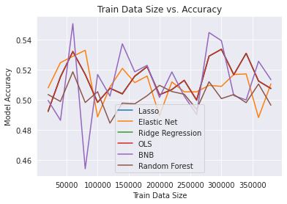
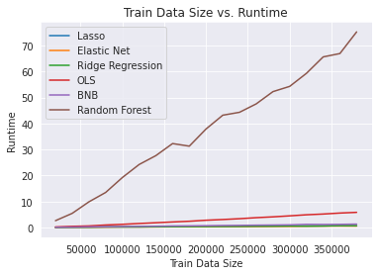
Model Selection: Accuracy vs Runtime
*K-Nearest Neighbors excluded due to extremely long runtimes

Slide 10
Model Selection
Accurate but Slow
Fast but Inaccurate
Elastic Net
Ridge Reg
GMM
LSTM
CNN
K-Nearest Neighbors
Ordinary Least Squares
Bernoulli Naive Bayes
Multinomial Naive Bayes
Lit Review

Slide 11
Hyperparameter Tuning
Assumptions:
We need to hold some variables constant
Training size
Return # Days
Anonymous features
Gridsearch & TimeSeriesSplit

Slide 12
LSTM Model

Slide 13


Recurrent Neural Networks (RNN) - Long Short Term Memory (LSTM)
Stores information from the past for an arbitrary length of time.
Resistant to noise.
C(t-1)
C(t)
Memory cells replace hidden layers
4 neural network layers: 3 sigmoid, 1 tanh
Cell state conveyor that adds and subtract information
The X and + are pointwise multiplication and addition
h(t-1)
h(t)

Slide 14
LSTM in depth
Finance
ARIMA and GARCH models are less effective with regime changes and risk-neutral models are not good predictors of stock performance
Random nonstationary and noisy sequences such as stock-price time series
Model Setting
epochs = [500, 2000, 5000]
batch_size = 3500 ( 1 week - 500 trades/day )
4 layers each with a dropout layer
Final layer with a sigmoid activation function

Slide 15
Convolutional Neural Network (CNN)

Slide 16
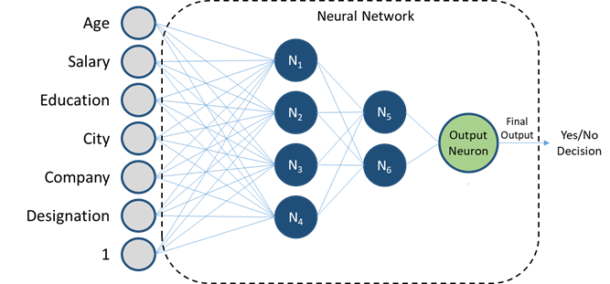
CNN Overview
Feature 1
Feature 2
Feature 3
1: Action
0: No Action
Feature 4
Feature 5
Feature 6
Feature 7
and on...
Input Layer
Hidden Layers
Output Layer
Notes:
In the hidden layers: Each node uses their own set of filters/rules to apply to each feature. Determines what weighting to assign to each feature.
Each node scans over features in chunks of overlapping blocks, as opposed to looking at entire dataset at once.
Goal: ID and extract the most important features from the dataset, and generate an output of 1, which is action, or 0 no action.

Slide 17
Hyperparameter Tuning
Improves Model
Does Not Improve Model
Kernel sizes
# of nodes in density layer
Sigmoid activation
# of nodes in convolutional layers
# of epochs
Training sizes
Batch sizes
Softmax activation
Notes:
Sigmoid: activation function that can tell you if a node is on or off.
Softmax: Softmax makes the output sum up to 1 so the output can be interpreted as probabilities

Slide 18
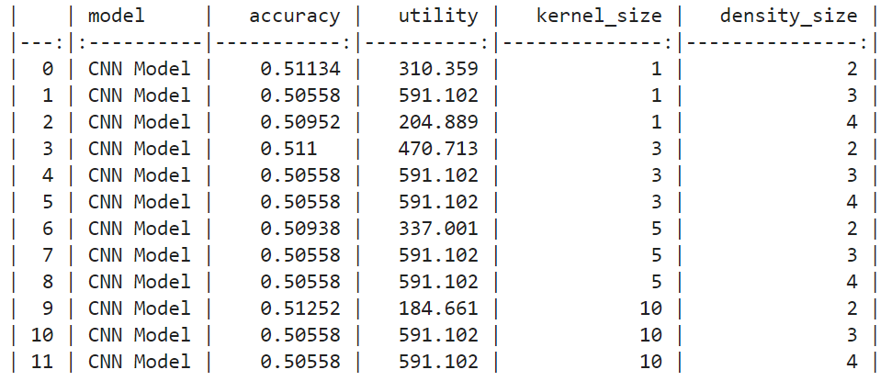
Results
Performance maximized through trial and error
Used variety of different kernel and density sizes
No consistently “best” model
Average over 12 Iterations
Training Size = 50,000
Kernel Sizes = [1, 2, 3, 10]
Density Sizes = [2, 3, 4]
Model Accuracy = 50.85%
Utility Score = 430.15
Notes:
Kernel: Size of the filter matrix for our convolution. 1 = 1x1 output. 10 = 10x10 output.
Density: We will have 2 nodes in our output layer, one for each possible outcome (1 = action, 0 = no action). Tested with more and did not do as well (utility increased but acc decreased).

Slide 19
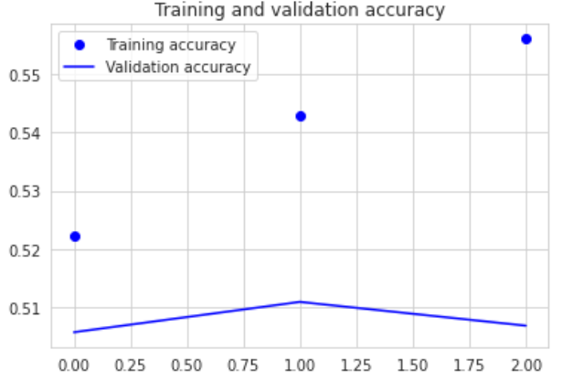
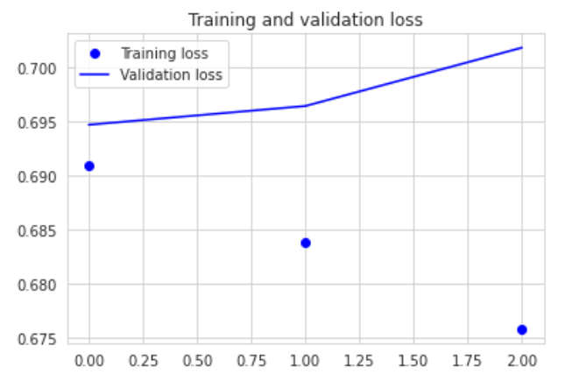
Results
Kernel Size of 3 & Density Size of 2 generated balance between high utility (470.7) and high accuracy (51.1%)
Accuracy remains consistent w/ incremental uptick in validation loss
Notes:
Kernel: Size of the filter matrix for our convolution. 3 = 3x3 output. 10 = 10x10 output.
Density: We will have 2 nodes in our output layer, one for each possible outcome (1 = action, 0 = no action).

Slide 20
Takeaways/Lessons
Accuracy and Utility Score in-line with other models
Accuracy did not improve with more iterations (ceiling @ 3 epochs)
Further improvement potential by implementing exhaustive Grid Search
Initial models incorrectly incl. test data within train data

Slide 21
Gaussian Mixture Model

Slide 22
Hyperparameter Tuning
Performance maximized with 2 GMM Components
Performance steady across covariance types
Improvement potential by implementing PCA
Initial Model
GMM Components = 2
PCA Components = 60
Training Data Size = 400,000
Model Accuracy = 51.28%

Slide 23
Evaluating Consistency of Model Performance
Vary Training Data Slice
Full Dataset = 500 Days
Vary Training Data Size

Slide 24
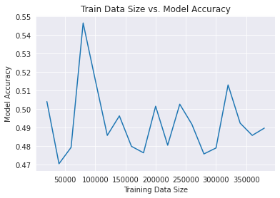
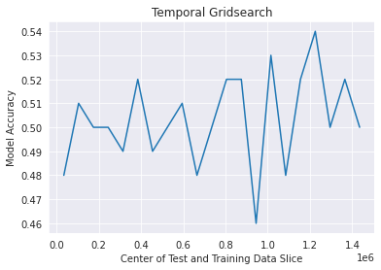
Accuracy Variation by Size and Slice

Slide 25
Summary
Preliminary success with 2 Component GMM Models
PCA resulted in reduction of model accuracy below 50%
No gain in accuracy by implementing competing models
Unreliable and Unpredictable

Slide 26
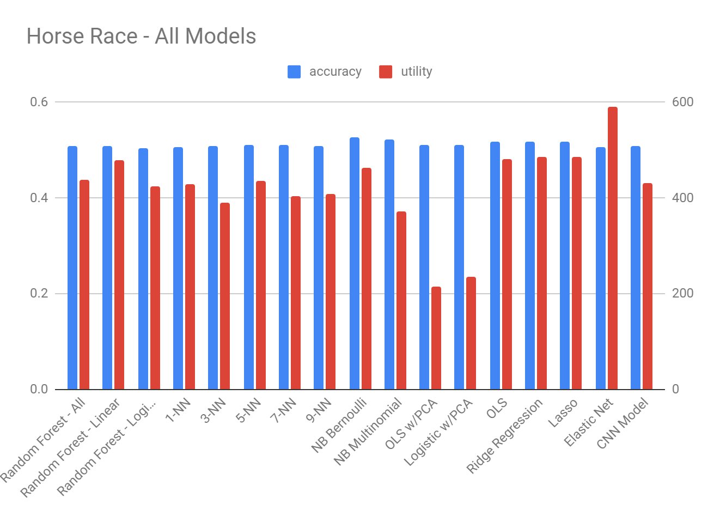
Conclusions

Slide 27
Appendix

Slide 28
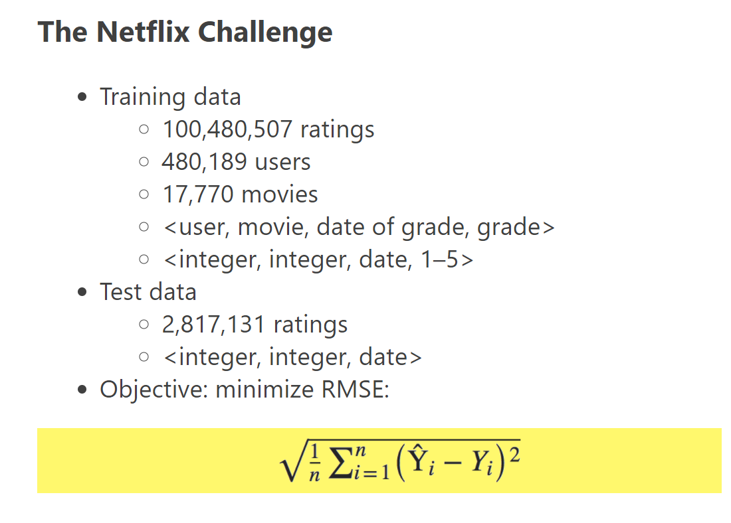
Template slide

Slide 29
Overview - Reduce # of words on this slide.
Variables
Resp: The percentage return, either positive or negative
Weight: Pre determined amount of money that we/Jane Street is willing to risk on that trade.
Action: 0 if the model does not make the trade, 1 if the model makes the trade
Solution
Run many different models
Train them on line items where there is a positive return (resp >= 0)
Predict the action to see which model most often correctly returns 1 (take the trade) whenever resp is positive and 0 (do not take the trade) whenever resp is negative.
Currently we have achieved 51-52% accuracy (in terms of score).
Per Kaggle rules, we will rank the models (horse race) based on utility score (generated from utility function) as opposed to accuracy.

Slide 30
Next Steps
Run unsupervised models
Comments
Is this panel data?
500 days
Define all variables to audience: eg. There is no meaning behind the features

